Slide 1


Slide 2


LIMA

Slide 3


OTTAWA

Slide 4

Loco Vargas is from LIMA, PERU.
He is from LIMA, PERU.

Slide 5

Gisela is from LIMA, PERU.
She is from LIMA, PERU.

Slide 6
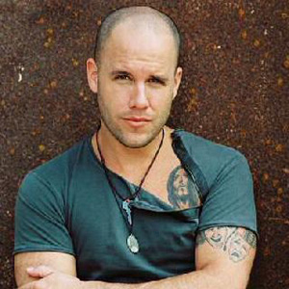

Gian Marco and Pedro are from LIMA, PERU.
They are from LIMA, PERU.

Slide 7

Country:
Nationality:
Australia
Australian

Slide 8

Country:
Nationality:
Brazil
Brazilian

Slide 9

Country:
Nationality:
The United Kingdom
British

Slide 10
Country:
Nationality:
Canada
Canadian

Slide 11

Country:
Nationality:
China
Chinese

Slide 12

France
Country:
Nationality:
French

Slide 13

Country:
Nationality:
Germany
German

Slide 14

Country:
Nationality:
Greece
Greek

Slide 15

Country:
Nationality:
Italy
Italian

Slide 16

Country:
Nationality:
Japan
Japanese

Slide 17

Country:
Nationality:
South Korea
Korean

Slide 18

Country:
Nationality:
North Korea
Korean

Slide 19

Mexico
Country:
Nationality:
Mexican

Slide 20

Country:
Nationality:
Poland
Polish

Slide 21

Country:
Nationality:
Portugal
Portuguese

Slide 22

Country:
Nationality:
Russia
Russian

Slide 23

Country:
Nationality:
Spain
Spanish

Slide 24

Country:
Nationality:
Sweden
Swedish

Slide 25

Country:
Nationality:
Turkey
Turkish

Slide 26

The U.S.A.
America
Country:
Nationality:
American

Slide 27
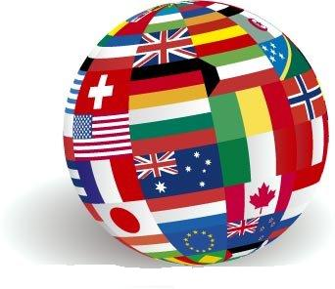
Where are they from?
What are their nationalities?

Slide 28
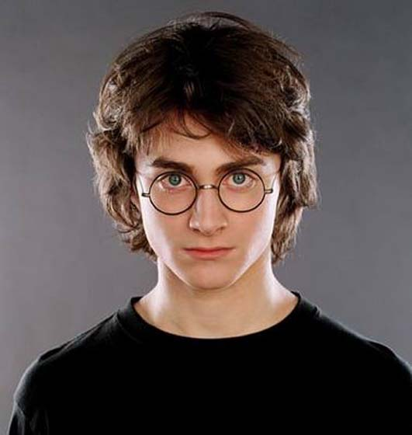

This is Daniel Radcliffe.
He is from England.
He is English.
ENGLAND

Slide 29





Mary is from England.
She is English.
Mary
Yumiko
Anna
Nicole
Sarah

Slide 30


Mary is from ....................
She is ....................
Sarah is from ....................
Mary
She is ....................
Sarah
Lili is from ....................
She is ....................
Eleni is from ....................
Lili
She is ....................
Eleni

Slide 31








Javi is from ....................
He is ....................
Akira is from ....................
Javi
He is ....................
Akira
Chen is from ....................
He is ....................
Louis is from ....................
Chen
He is ....................
Louis

Slide 32
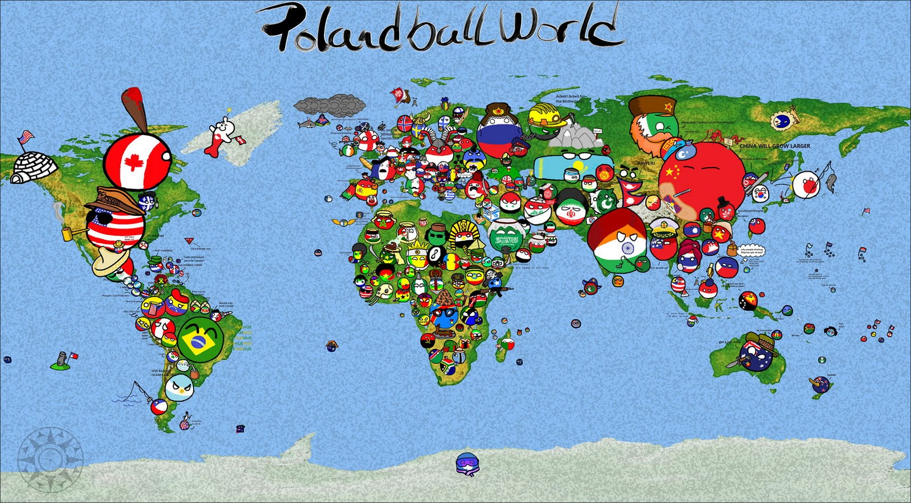
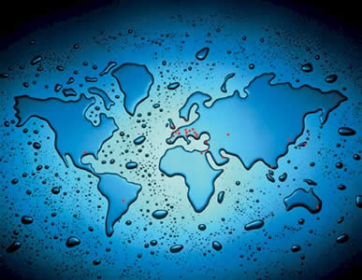
Where in the WORLD?

Slide 33

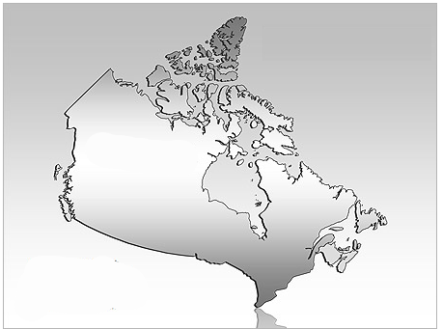

Slide 34
THE U.S

Slide 35



Slide 36
ARGENTINA

Slide 37

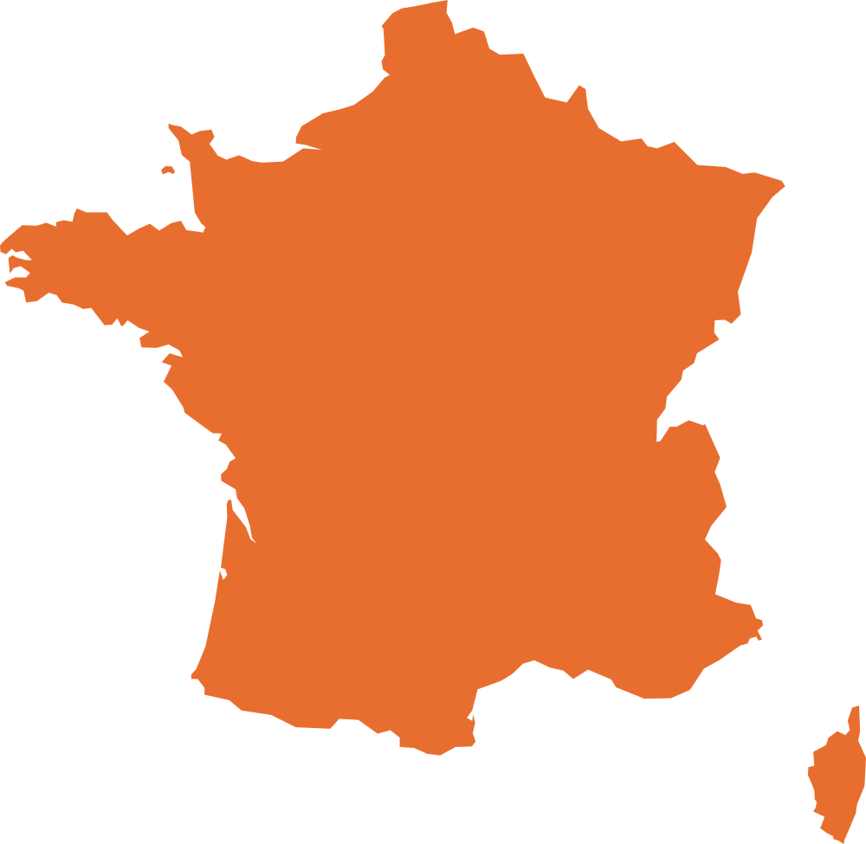

Slide 38
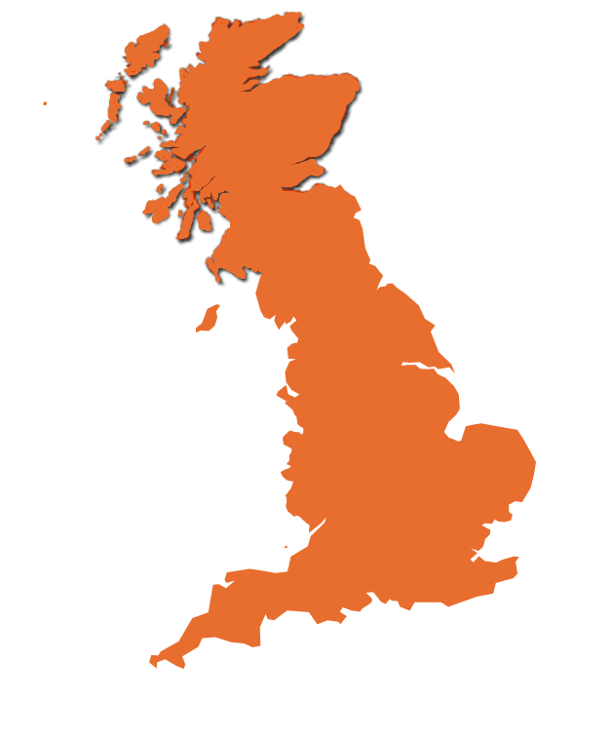


Slide 39
NEW ZEALAND

